Slide 1
Syntactic Analysis (Parsing)
Week 5

Slide 2
Learning Outcomes
Explain the role of syntactic parsing in NLP and its importance in linguistic structure analysis.
Differentiate between dependency and constituency parsing.
Implement a basic syntactic parser using Python and the NLTK library.

Slide 3
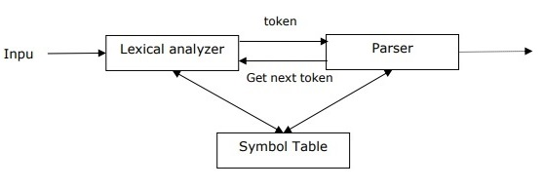
A Parser
The software that takes input data (text) and gives structural representation of the input after checking for correct syntax as per formal grammar.
The origin of the word ‘parsing’ is from Latin word ‘pars’ which means ‘part’.
Types of Parsing in NLP: Syntactic parsing; Semantic parsing
FUNCTIONS of a parser
To report any syntax error.
To recover from commonly occurring error so that the processing of the remainder of program can be continued.
To create parse tree.
To create symbol table.
To produce intermediate representations (IR).

Slide 4
How does a Parser work?
The first step is to identify the sentence’s subject.
The parser divides the text sequence into a group of words that are associated with a phrase. So, this collection of words that are related to one another is referred to as the subject.
Syntactic parsing and parts of speech are context-free grammar structures that are based on the structure or arrangement of words. It is not determined by the context.
NOTE: The most important thing to remember is that grammar is always syntactically valid, even if it may not make contextual sense.

Slide 5
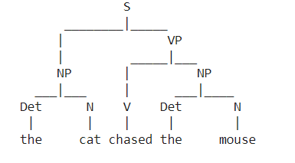
Syntactic Parsing
This is the process of analyzing the structure of a sentence to determine how its components (words) relate to each other grammatically.
It involves looking at the sentence to determine parts of speech, sentence boundaries, and word relationships.
Parse Trees: Visual representation of sentence structure.
Approaches of syntactic parsing
Constituency parsing
Dependency parsing

Slide 6
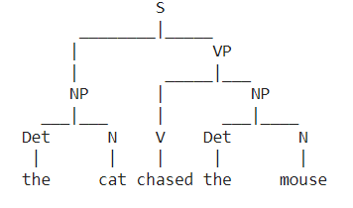
Constituency Parsing
Constituency Parsing decomposes a sentence into subphrases (e.g., noun phrases, verb phrases).Focuses on breaking the sentence into constituent parts or phrases.
Parse Tree: Shows how sentences are hierarchically organized into phrases.
Phrase Structure Rules: Explain how grammar rules (like S -> NP VP) govern sentence structure.

Slide 7
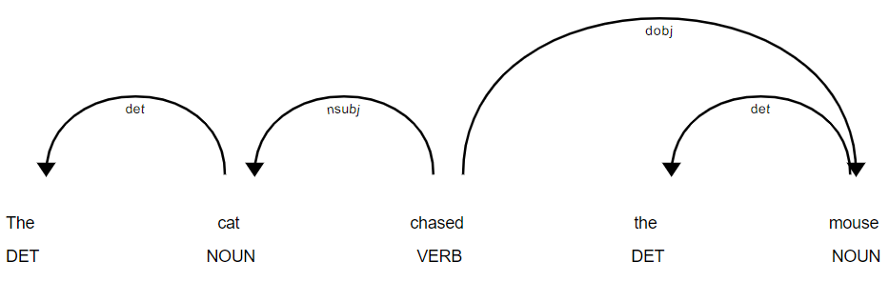
Dependency Parsing
Dependency Parsing focuses on relationships between words (e.g., "subject" or "object"). Example: Parse the sentence "The cat chased the mouse" using both parsing methods.

Slide 8
Parsing Techniques in NLP
Top Down parsing
The parser starts constructing the parse tree from the start symbol and then tries to transform the start symbol to the input.
The most common form of topdown parsing uses recursive procedure to process the input.
The main disadvantage of recursive descent parsing is backtracking.
Bottom up parsing
The parser starts with the input symbol and tries to construct the parser tree up to the start symbol.

Slide 9
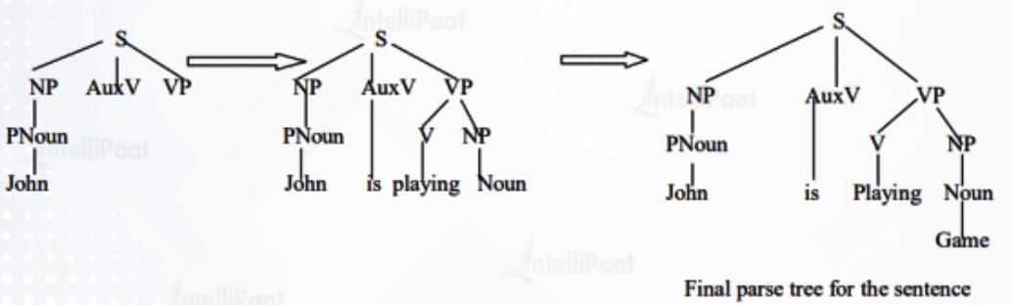
Top Down Parsing
Let’s consider the grammar rules:
Sentence = S = Noun Phrase (NP) + Verb Phrase (VP) + Preposition Phrase (PP)
Take the sentence: “John is playing a game”, and apply Top-down parsing

Slide 10
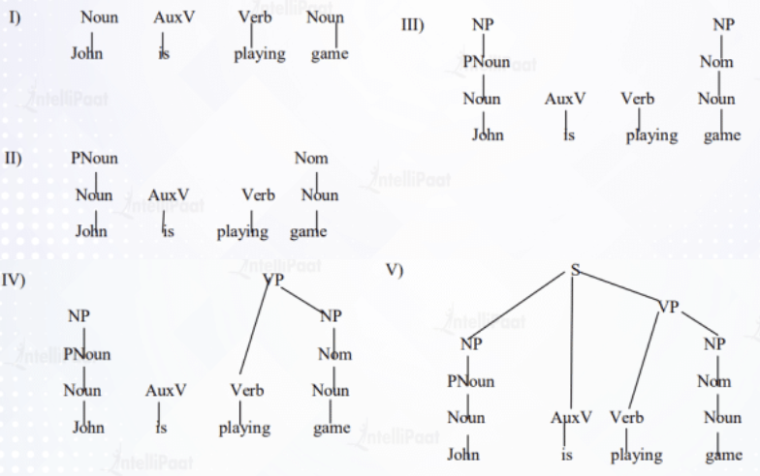
Bottom Up Parsing

Slide 11
Concept of Derivation
In order to get the input string, we need a sequence of production rules.
Derivation is a set of production rules.
During parsing, we need to decide the non-terminal, which is to be replaced along with deciding the production rule with the help of which the non-terminal will be replaced
The parse tree is a graphical depiction of a derivation
The start symbol of derivation serves as the root of the parse tree.
In every parse tree, the leaf nodes are terminals and interior nodes are non-terminals.
Left-most Derivation
Right-most Derivation
Notes:
In the left-most derivation, the sentential form of an input is scanned and replaced from the left to the right. The sentential form in this case is called the left-sentential form.
In the right-most derivation, the sentential form of an input is scanned and replaced from right to left. The sentential form in this case is called the right-sentential form.

Slide 12
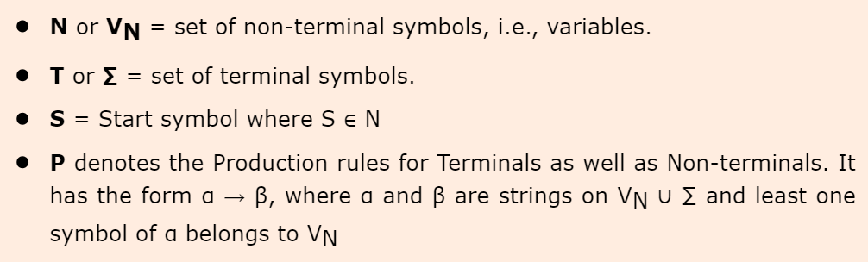
Concept of Grammar
A mathematical model of grammar was given by Noam Chomsky in 1956, which is effective for writing computer languages.
Mathematically, a grammar G can be formally written as a 4-tuple (N, T, S, P) where −
Notes:
A mathematical model of grammar was given by Noam Chomsky in 1956, which is effective for writing computer languages.

Slide 13
Applications of Parsing
Syntactic Analysis
Named Entity Recognition (NER)
Machine Translation
Question Answering
Text Summarization
Information Extraction
Notes:
Syntactic Analysis: Parsing helps in determining the syntactic structure of sentences by detecting parts of speech, phrases, and grammatical relationships between words. This information is critical for understanding sentence grammar.
Named Entity Recognition (NER): NER parsers can detect and classify entities in text, such as people’s, organizations, and locations’ names, among other things. This is essential for information extraction and text comprehension.
Semantic Role Labeling (SRL): SRL parsers determine the semantic roles of words in a sentence, such as who is the “agent,” “patient,” or “instrument” in a given activity. It is essential for understanding the meaning of sentences.
Machine Translation: Parsing can be used to assess source language syntax and generate syntactically correct translations in the target language. This is necessary for machine translation systems such as Google Translate.
Question Answering: Parsing is used in question-answering systems to help break down a question into its grammatical components, allowing the system to search a corpus for relevant replies.
Text Summarization: Parsing is the process of extracting the essential syntactic and semantic structures of a text, which is necessary for producing short and coherent summaries.
Information Extraction: Parsing is used to extract structured information from unstructured text, such as data from resumes, news articles, or product reviews.

